Slide 1

Machine Learning is for Everyone
www.BigDataTrunk.com

Slide 2
Introduction
Antony Ross
Data Science and Machine Learning
Sports performance data
Research in music recommendations and voice recognition
Presently working with financial data

Slide 3
Agenda
01
Machine Learning Overview
02
ML Algorithms
03
Model Selection
04
Python Libraries for ML
05
Next Steps

Slide 4
Logistics
Timing – 9 to 12 PM PST
Periodic Breaks – At logical points

Slide 5
Machine Learning

Slide 6
Machine Learning
Algorithms

Slide 7
Model Selection

Slide 8
ML Process
Scikit-learn
Demonstration

Slide 9
Survey Time
http://ttseval.stanford.edu

Slide 10
Next steps
Make a custom plan for yourself to continue this journey
Improve some of your skills (Stats, Python, ML, Domain, etc.)
Take some additional courses
Try a Kaggle.com competition
Work on a personal project to improve understanding

Slide 11
Useful Data Science and Machine Learning books for beginners to intermediate:
Book | Author
Data Smart: Using Data Science to Transform Information Into Insight | John W. Foreman
Naked Statistics: Stripping the Dread from the Data | Charles Wheelan
An Introduction to Statistical Learning | Robert Tibshirani and Trevor Hastie
Python Machine Learning | Sebastian Raschka and Vahid Mirjalili
The Hundred-Page Machine Learning Book | Andriy Burkov

Slide 12
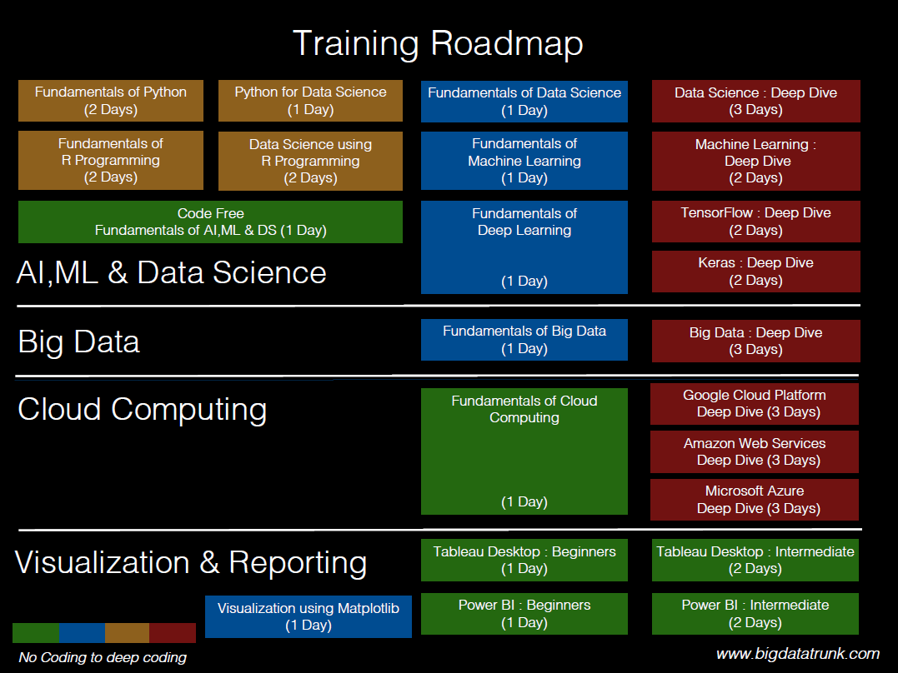

Slide 13
